Slide 1
Dimensional Confluence: Enhancing Ideation and design review in Metaverse-Enabled Design Studios
BMW virtual Design Hub
FG-430

Slide 2
Table of content
Dimensional Confluence: Enhancing Ideation and Design Review in Metaverse-Enabled Design Studios
BMW virtual Design Hub
User Requirement
Usecase specification
User Study
Evaluation

Slide 3
User Requirement

Slide 4
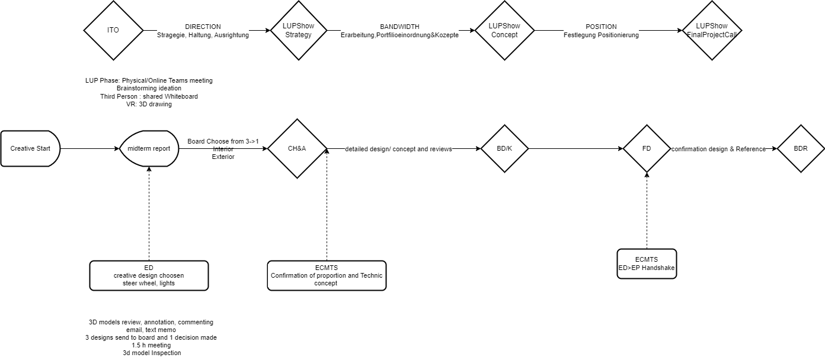

Slide 5
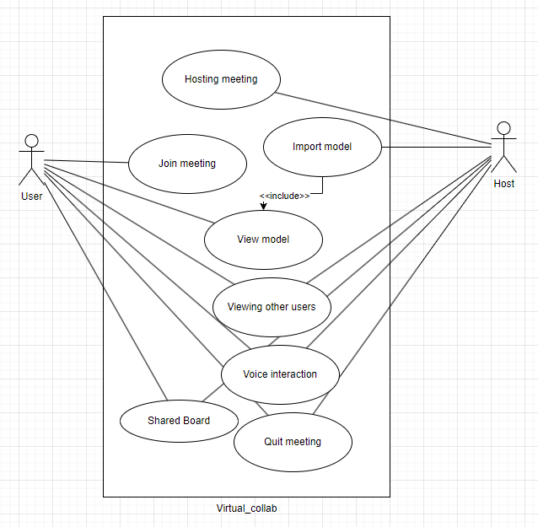
Usecase specification

Slide 6
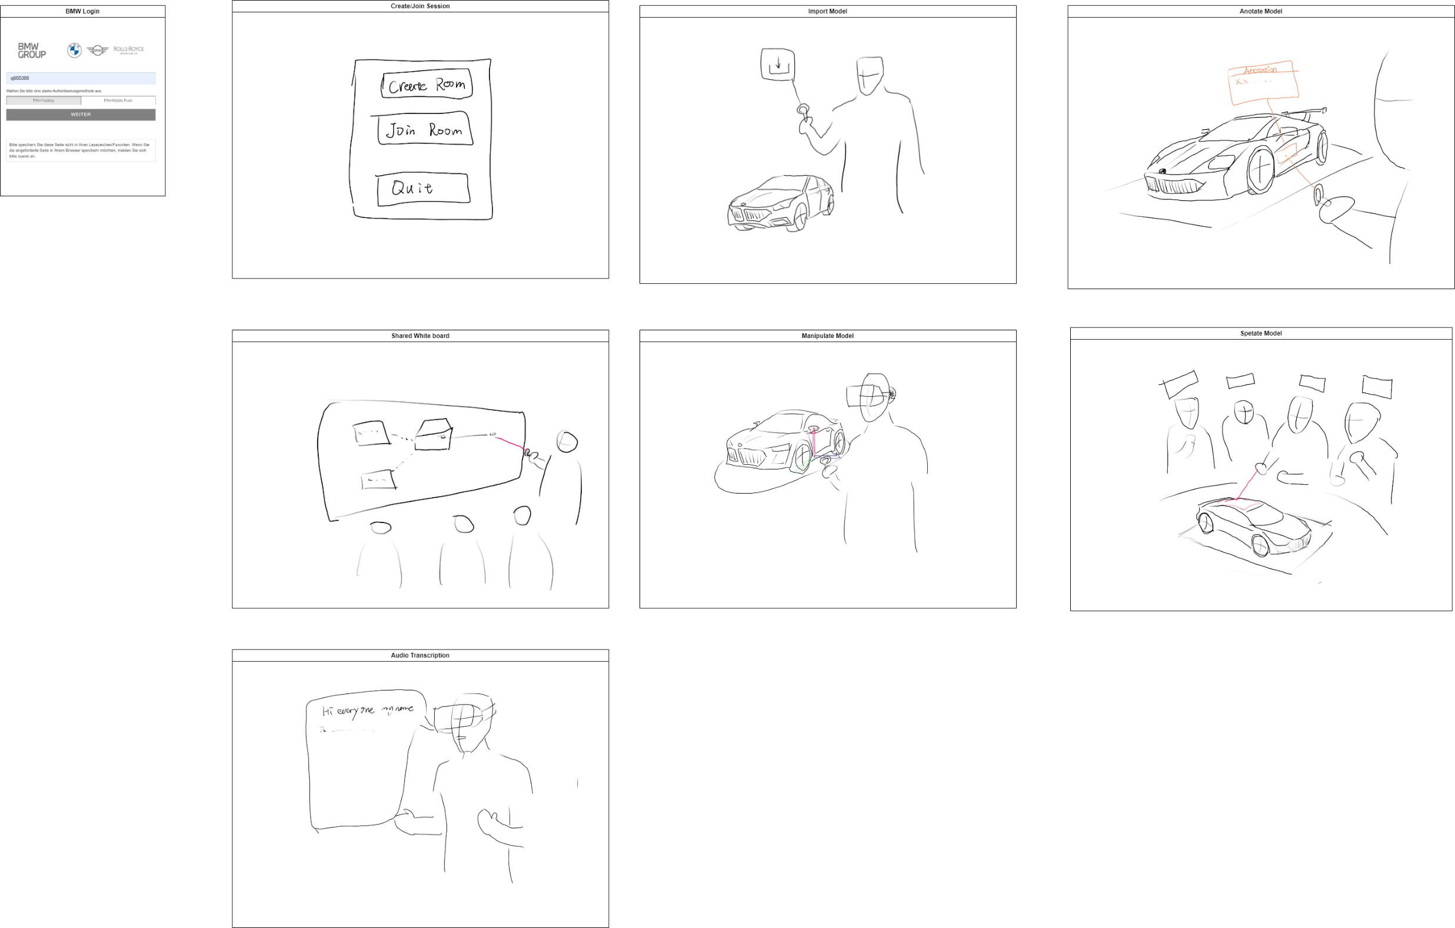

Slide 7
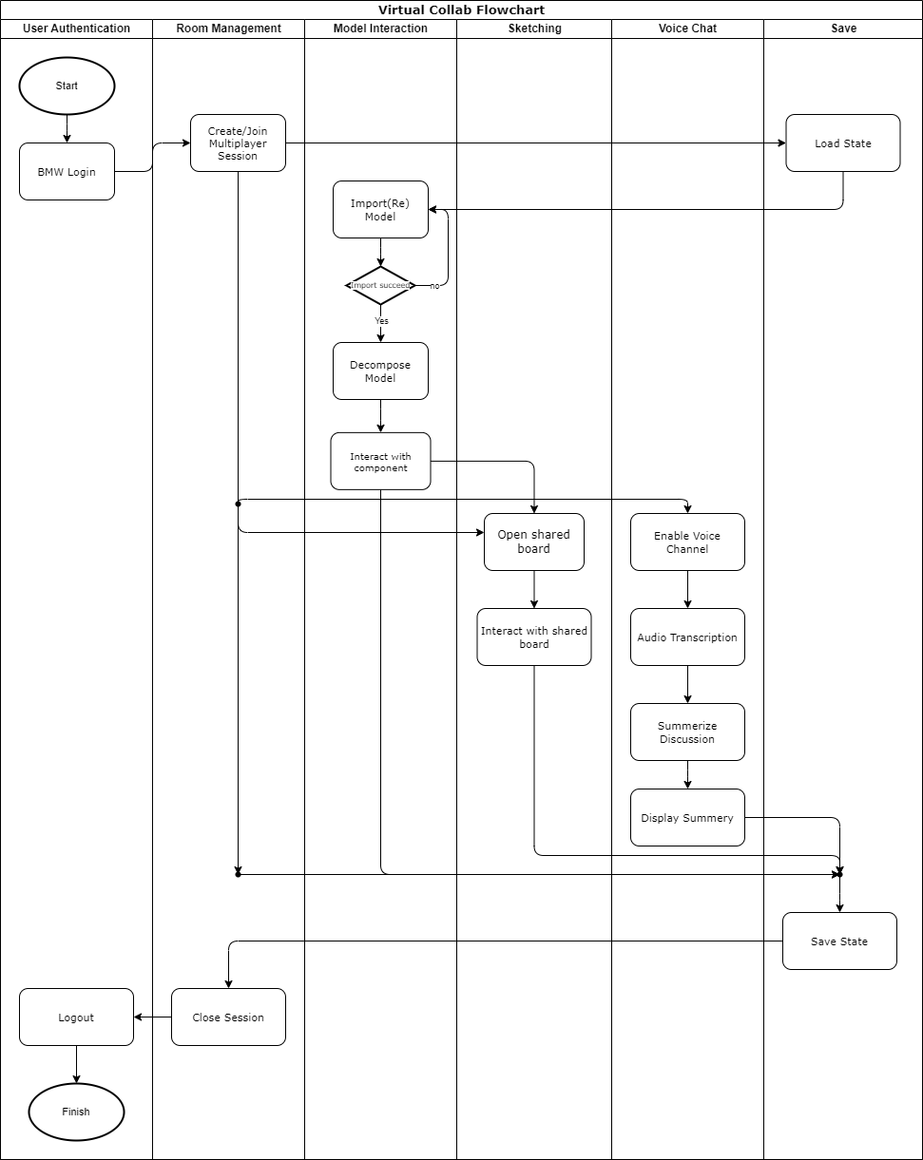

Slide 8
User Study
Walkthrough Method
- Evaluate Final Application
- System Usability Scale (SUS): measure subjective usability of products and services
- User Experience Questionnaire (UEQ)
- Semi-structured interviews

Slide 9
Conclusion & futurework

Slide 10
Thankyou

